Slide 1


Latent Class Analysis
WINTER 2022 | KRISTA MILLER & EMMA BRIGHT

Slide 2



Research Question
Background
Survey data provides companies with an opportunity to gather information regarding specific topics from target respondents. Latent Class Analysis is used to provide insight into survey data by identifying latent classes of customers based on independent observations and latent variables
The goal of our research is to....
Categorize Starbucks customer survey respondents into different types of customers based on their consumption behaviors and perceptions of their retail experiences.
01/10
Notes:
Mention the dataset – talk about it a little.

Slide 3

02/10
Latent Class Analysis
CONCEPT
ASSUMPTIONS
LCA is a statistical analysis technique that can be used to classify data and used as an exploratory analysis tool to implement other statistical methods, such as regression.
No assumptions related to linearity, normal distribution or homogeneity of the data.
The data must consist of categorical or ordinal features
In LCA, classes are identified and created from latent, non-observable, variables within individual responses from survey data.
Examples could include a person’s level of neurosis, conscientiousness or openness to answering questions.
Observations should be independent.
Groups are mutually exclusive and exhaustive – you can only belong to one group and the data encompasses all groups.
Notes:
What’s a latent variable?
An unobservable variable.
The assumption underlying LCA is that membership in unobserved groups (or classes) can be explained by patterns of scores across survey questions, assessment indicators, or scales.
A variety of reasons can cause latent, non-observable, variables. People may not want to be honest, or they may not be aware themselves of any important factors. For example, a person’s level of neurosis, conscientiousness or openness are all latent variables; They are almost impossible to measure directly.
Examples of latent classes, where participants can form groups based on these hidden variables, include: “non-drinkers vs. drinkers”, “drug-use”.
This form of analysis can be especially helpful within the healthcare field where there may be a sense of “taboo” about answering questions in a particular way.

Slide 4

Survey Questions
Data
The dataset utilized for our Latent Class Analysis was collected from Kaggle.
The Starbucks Customer Survey dataset consists of 112 independent customer responses to 21 survey questions.
Latent Classes
03/10
Notes:
Why use LCA on this set?
1. We wanted to explore clustering.
Because it’s survey data – and LCA is frequently used for clustering with survey data.
What's the difference between using LCA and K-means or another form of clustering?
K-means believes that what you respond is what you mean – it doesn’t consider “latent” variables such as openness to responding/hidden taboo information
LCA, on the other hand, assumes that latent classes exist and explain patterns of observed scores across cases.
In cluster analysis, variable means are used to define “nearness” of cases; therefore, analysis variables should be continuous.
In LCA, because the analysis variables are categorical, cross-tabulations are used as the input information
Why did we choose this dataset?
In LCA It’s the responsibility of the researcher to label the latent classes using LCA, we understood the variables within the set and can label classes appropriately – not necessarily the case with complex mental health/healthcare data.
Given that It’s the responsibility of the researcher to label the latent classes - it’s particularly important to perform exploratory analysis and understand their sample population and where the data was collected or generated, because it provides additional context for labeling.

Slide 5



Data Preparation
Exploratory Analysis
Variable Selection
Encode Data
07/10
04/10
Notes:
Exploratory Analysis
We performed univariate, bivariate, and multivariate analyses to identify correlations between our features and use reasonable judgment to determine which variables to select for our LCA Analysis.
Variable Selection
Its up for debate whether/how it’s useful for LCA. We explored R packages that were designed for dimensionality reduction, however, after reading and performing some research on LCA it made more sense to choose variables on our own that we thought would be useful for classification, because we must interpret the output by variable rather than looking at a holistic outcome of a model. There is no maximum or minimum recommendation of variables to be included.
Finally, we must
Encode Data
We performed two types of categorical Encoding is a process where we transform categorical data into numerical data. We used a combination of one-hot encoding and label encoding to prepare data for analysis.
One-Hot Encoding or OHE is a technique that transforms all the elements on a categorical column into new columns represented by 0 or 1 (binary values) (product types bought frequently ) to signify the presence of the category value.
Label Encoding was different — the process transforms categorical column elements into numerical values without any additional column.
Manifest Variables
In order to use the encoded data, our LCA model needed to have positive integers – so we added 1. “What are manifest variables?”
Manifest Variable:
In latent variable models , a manifest variable (or indicator) is an observable variable - i.e. a variable that can be measured directly. A manifest variable can be continuous or categorical. It cannot be 0 – so we had to add 1 to all our variables (one-hot encoding)
The opposite concept is the latent variable .

Slide 6
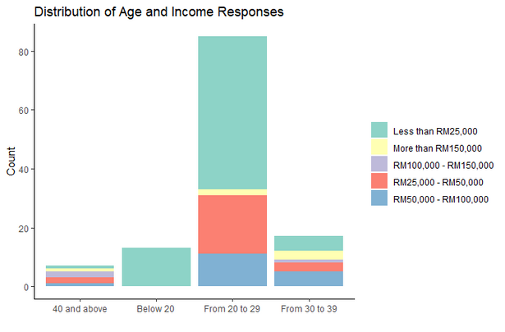

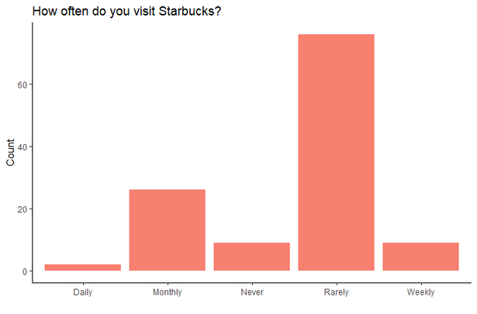
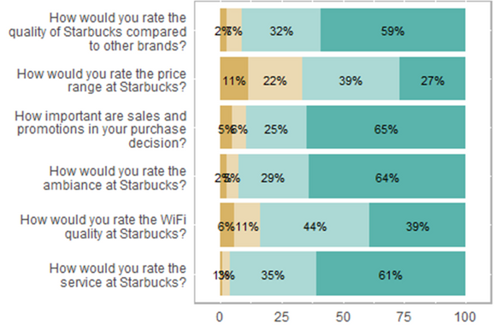
Exploratory Analysis
DEMOGRAPHIC VARIABLES
Income and Age
BUYER BEHAVIOR VARIABLES
Time spent and How they Consume
EXPERIENCE VARIABLES
Rating of Product Quality & Rating of Service
Notes:
As we dove into our exploratory analysis, we found a natural divide in the types of survey questions that were asked:
-Demographic (things like: income, age, employment status, gender)
-Buyer Behavior (how much time they spent in store, how coffee is purchased (drive through, walk in, dine in), location (proximity to their house), and how much money they spent.
-Experience variables represented their ratings and perceptions about their experience at Starbucks. These questions captured information on how they rated ambiance, service, feelings about sales and promotions, and quality
Given that we needed to select our variables for the model, we thought it was reasonable to choose 2 variables from each of these categories:
Demographic information-> we chose income and age. We thought that employment status highly correlated with income, and gender also actually correlated with employment status (since one of the responses was ‘housewife’, which automatically assumes gender).
Buyer behavior variables -> we chose time spent and how they consumed Starbucks. We dropped how much money they spent (also correlated with income), and we just weren’t that interested in location.
Finally,
Experience variables -> we thought we would get the most information from the product quality rating and service perceptions rather than how they rated variables like wifi and promotions.
Then created several visualizations, a few of which are presented here:
Interesting things to note:
We thought that the respondents may not be regular Starbucks customers and the survey may have been included as some sort of promotional offer because the Visit Frequency was primarily "Rarely“ and there were so few people who responded as “Daily” visitors. We were concerned that this could impact our analysis as we're looking to cluster customers into distinct groups.
In terms of the age distribution, we thought it was interesting that the respondents to the survey were largely from the 20-29 age group. That may say something about who is actually willing to fill out a survey and if compensation was involved (both of which could actually be latent variables).
-So, out of curiosity, we went back to the metadata and saw that this survey was conducted in Malaysia through a Google form in the month of September 2019. Unfortunately, we don’t have any other details about how the survey was written or distributed.

Slide 7

Outcome
Latent Classes
USING THE JUDGEMENTALLY SELECTED FEATURES FROM OUR EXPLORATORY ANALYSIS, WE FOUND THAT THE NUMBER OF LATENT CLASSES PRESENT WITHIN OUR DATA IS 2.
06/10
Notes:
Once we selected our 6 variables, we placed them in the LCA model.
Latent class models are estimated by iteratively adding potential classes to determine which model is best fit to the data.
Judging “best fit” requires consideration of several conditions. Not just minimizing information criteria (which is shown on the graph here), but it is also important to consider model interpretability.
Information criteria measurements (like AIC and BIC ) reflect how well the model predicts the data, with smaller values indicating a better model fit.
Of note, we read that BIC is the most commonly reported statistic for comparing LCA model results.
We ended up selecting 2 classes for 3 reasons:
Lowest AIC
Had a low(er) BIC
Had the highest model parsimony (which is another word for interpretability)
If we had 1 latent class, we could assume that it was a very homogenous group who answered the survey, which goes back to some of the concerns we had with our exploratory analysis.

Slide 8
 | Class 1 | Class 2
 | Age
Below 20 | 0.1 | 0
20-29 | 0.8 | 0.25
30-39 | 0.06 | 0.47
40+ | 0.01 | 0.27
 | Income
< RM 25,000 | 0.68 | 0.08
RM 25,000 - RM 50,000 | 0.2 | 0.21
RM 50,000 - RM 100,000 | 0.11 | 0.31
RM 100,000 - RM 150,000 | 0 | 0.14
> RM 150,000 | 0 | 0.23
 | Time Spent
< 30 min | 0.62 | 0.3
30 min - 1 hour | 0.27 | 0.4
1 - 2 hours | 0.07 | 0.2
2 - 3 hours | 0 | 0.04
> 3 hours | 0.02 | 0
 | How Product Consumed
Dine-In | 0.35 | 0.55
Drive-thru | 0.14 | 0.31
Take Away | 0.49 | 0.13
 | Product Rate
1 | 0 | 0
2 | 0 | 0.04
3 | 0.06 | 0.1
4 | 0.34 | 0.04
5 | 0.34 | 0.79
6 | 0.25 | 0
 | Service Rate
1 | 0 | 0
2 | 0 | 0
3 | 0.03 | 0.04
4 | 0.29 | 0.4
5 | 0.44 | 0.44
6 | 0.22 | 0.1
Notes:
After we ran our model with our 2 selected classes, this was actual output, which we have shown here in a heatmap visualization.
To, interpreting this model, probabilities are generated based on the assumption of underlying latent variables and NOT the direct response. If you were a class 1 member, the probability that you responded that your age was 20-29 was 80%.
IN other words, this does not mean 80% of survey respondents are actually 20-29, this means that given you are in class 1, you are likely to RESPOND that you are 20-29 regardless of accuracy/truthfulness. The outputs are the probabilities HOW you would answer a question a certain way, given your class membership. Again, this is a difference between LCA and k-means clustering.
To quickly summarize all of the variables:
We found that if you were in class 1, you were likely to respond that you were younger, poorer, on-the-go, and you were spending less than 30 minutes at Starbucks. This group was also more likely to highly rate the service and rate the product as mid-tier.
In you were in class 2, you were likely to respond that you were over 30, have some income, and have more time to spend drinking coffee at a Starbucks. This group was more likely to rate the service as mid-tier and highly rate the product.

Slide 9
Class 1
Poor, Elder Millennials
81.25%
Predicted class memberships (by modal posterior prob.)
Final Thoughts
Our research question was to characterize our survey respondents. We were able to do this by creating two distinct latent classes.
Next Steps
What do researchers do with LCA analysis?
Class 2
Comfortable, Gen X’ers
18.75%
Predicted class memberships (by modal posterior prob.)
09/10
Notes:
As some final thoughts:
Our research question was to characterize our survey respondents. We were able to do this by creating two distinct latent classes.
-The final step is to assign Class labels, which you can see here:
We determined that class 1 was composed of poor, elder millennials and class 2 members were comfortable, gen x’ers. 81.25% of the surveyed population were predicted to be in class 1, while 18.75% of the survey population were predicted to be in class 2. given that one of our assumptions of LCA is mutual exclusive and exhaustive groups, a researcher could generalize this to make assumptions about the general population that visits this Starbucks location.
In summary, LCA is a method that can be applied to complex datasets to organize observed variables that represent unobservable constructs into two or more potentially meaningful, homogenous subgroups
-Now what?
LCA can be particularly useful for identifying subgroups who could benefit from a common intervention based on their shared characteristics and similar survey patterns. In terms of our dataset, Starbucks could use this information for targeted recommendations or campaigns, and drive other business decisions to increase revenue.

